Slide 1

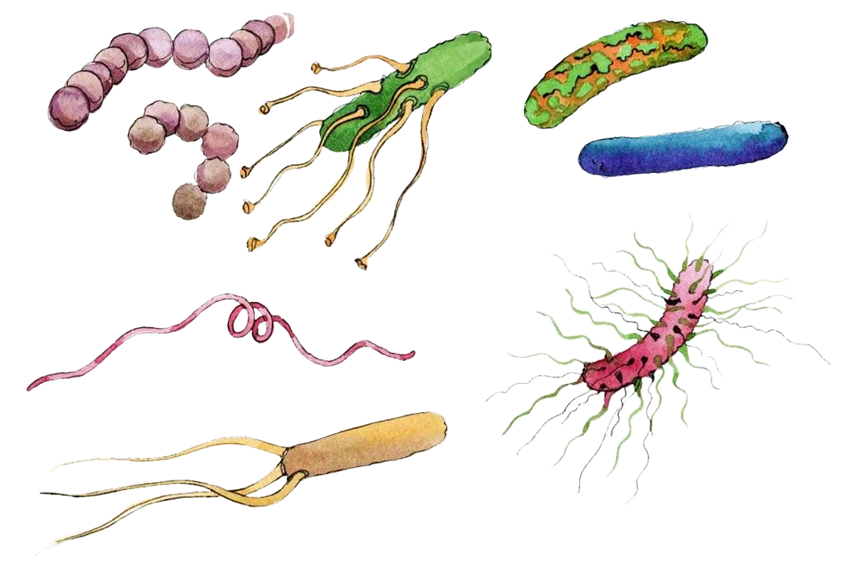


Understanding the effect of light on
soil microbial diversity and function
Referent : Lisa WINGATE
Clément FOUCAULT

Slide 2



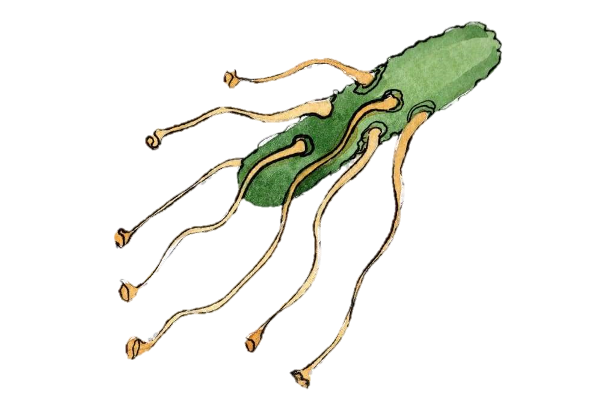
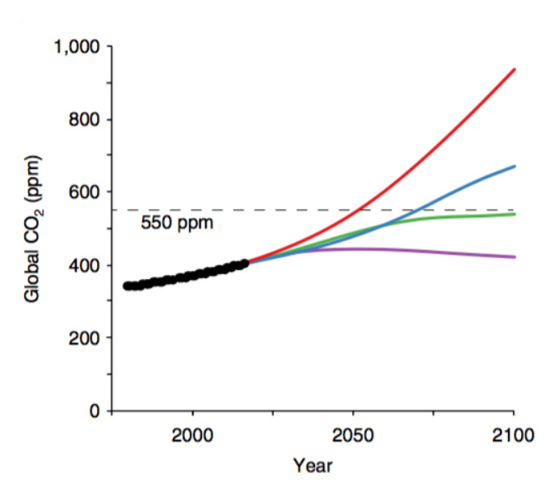
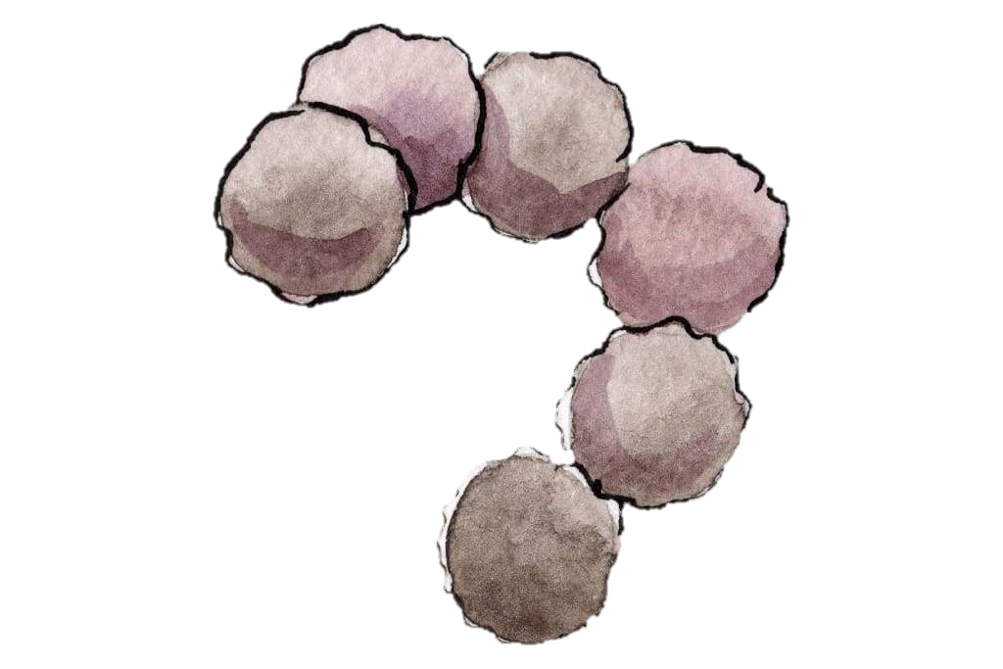
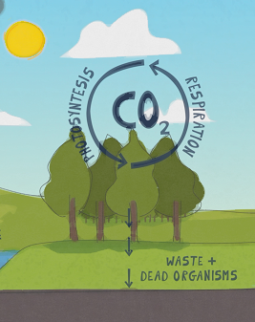
Carbon cycle main fluxes in natural ecosystems are
Will lands ecosystems act as source or sink ?
→ Crucial knowledge to estimate future atmospheric CO2 concentrations.
PHOTOSYNTHESIS
and
RESPIRATION
Source data : Global Carbon Project
Notes:
The carbon cycle in natural ecosystems is composed of two main fluxes : photosynthesis, primarily carried out by terrestrial plants and marine eukaryotic algae, and respiration by auto and heterotrophic organisms. As such, it is imperative to quantify their contribution to the global CO2 flux in order to estimate future atmospheric CO2 concentrations, for their balance determines if land ecosystems act as sources or sinks for CO2.

Slide 3
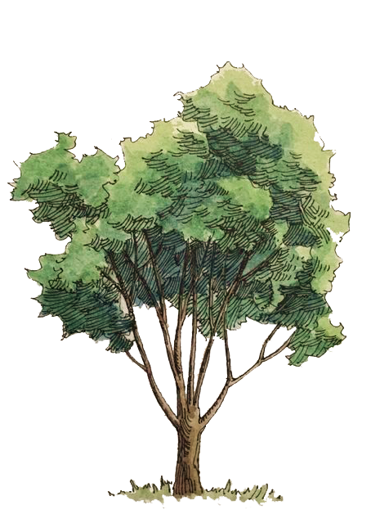




COS
COS is hydrolyzed in leaves by carbonic anhydrase (CA).
H₂O
Source : Sandoval-Soto et.al, 2005
CO₂
H₂S
6CO2
Leaves harness solar energy in presence of CO2 and water and convert it into chemical energy.
6H₂O
C6H12O6
6O2
Notes:
A new method has received growing attention over the last decade, which uses the uptake of carbonyl sulphide, a trace atmospheric sulfur gas, as a proxy for ecosystem primary gross production. In leaves, COS is taken up along CO2 and both gases react with the same enzyme : carbonyl anhydrase.

Slide 4
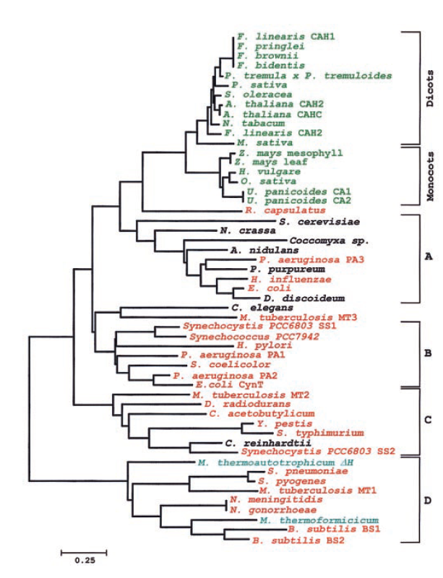
CA : an ubiquitous enzyme !
Eukaryotes are in green.
Lower eukaryotes in black.
Bacteria in red.
Archaea in blue.
Carbonic anhydrase is a very ancient enzyme.
Root of CA on the tree is estimated around -4.2Ga.
Phylogeny of B-class CA
Source : Smith et.al, 1999
Notes:
Carbonyl anhydrase is an ubiquitous enzyme for exchanging and equilibrating CO2, and as such, it is shared amongst a wide range of organisms.

Slide 5
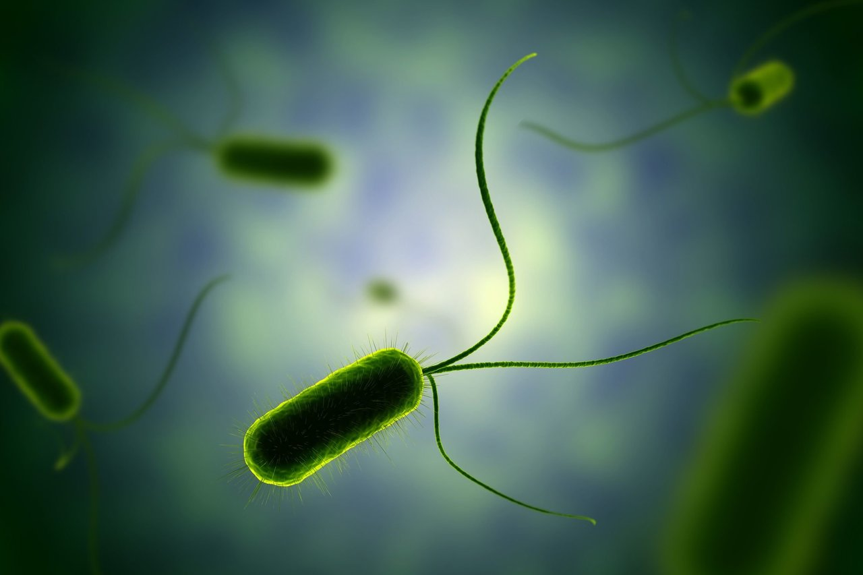
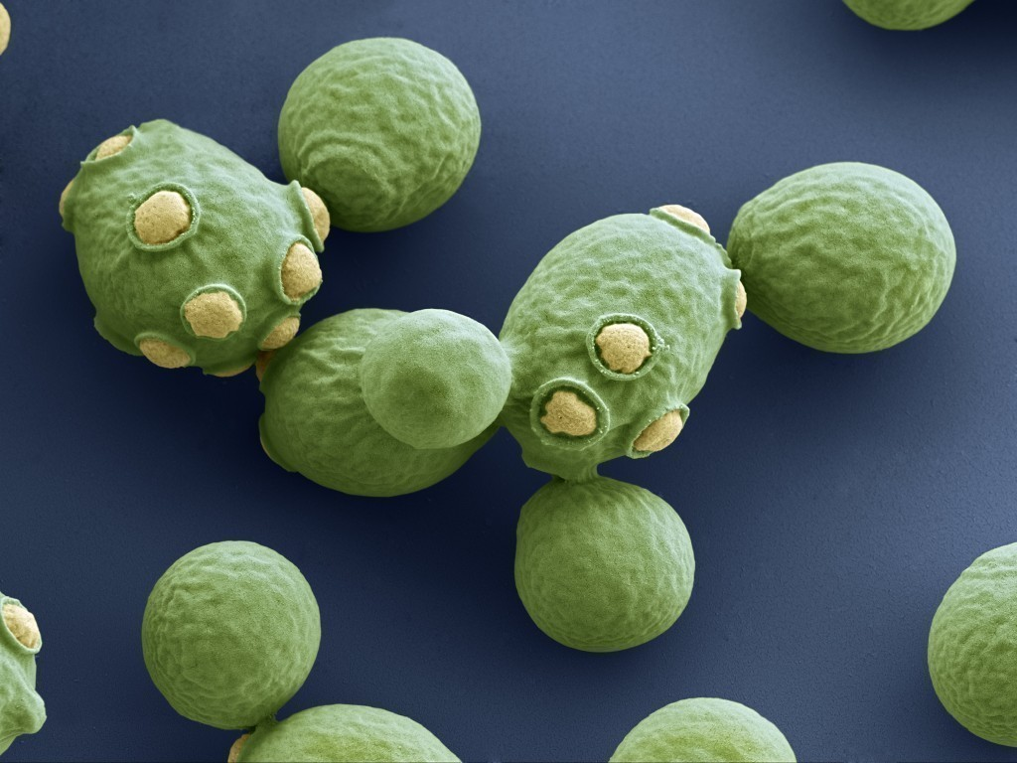
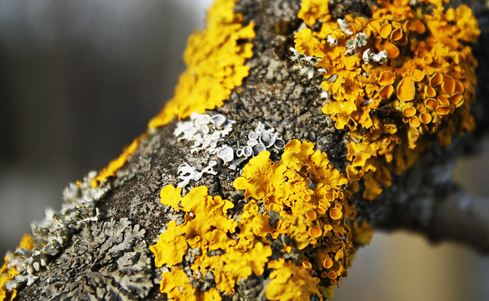
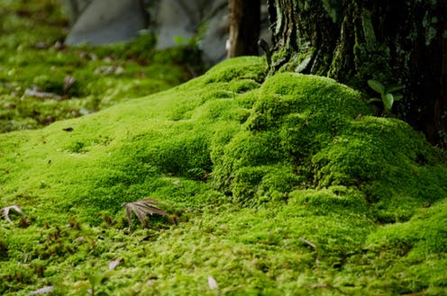

CA : an ubiquitous enzyme !
Bacteria
Fungi
Eukaryotes are in green.
Lower eukaryotes in black.
Bacteria in red.
Archaea in blue.
Lichens
Mosses
Carbonic anhydrase is a very ancient enzyme.
Root of CA on the tree is estimated around -4.2Ga.
Phylogeny of B-class CA
Even plants and animals !
Source : Smith et.al, 1999
Notes:
including auto and heterotrophic bacteria, fungi, lichens, moss, plants and even animals. The main roles of CA are carbon fixation, Sulphur metabolism and regulation of intracellular pH.
CAs are diverse, they include six known classes that can thereafter be subdivided in clades. These different families have different affinities to CO2 and COS and different expression rates. Therefore, COS fluxes linked to CA activity are dependent on community composition since it will affect the kind of CAs we’ll find.

Slide 6
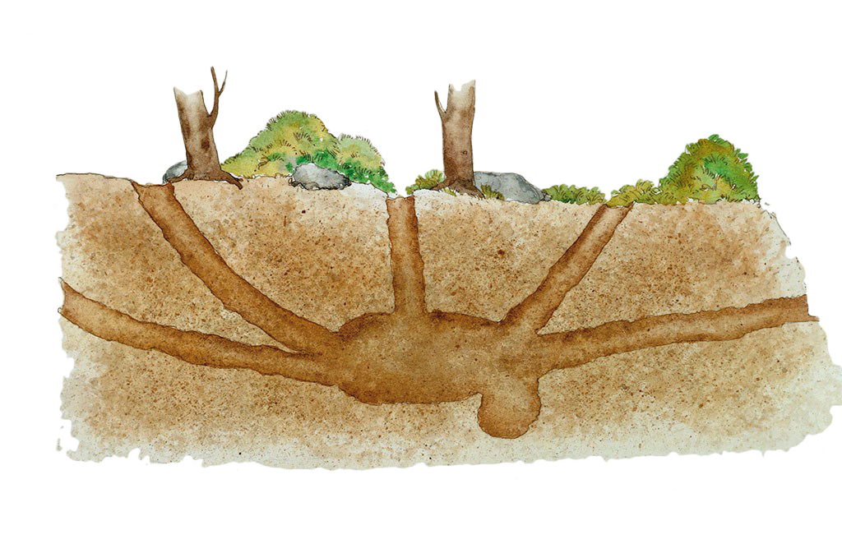
Soils are significant COS contributors !
Notes:
Now that is has been said, it probably isn’t surprising to hear that soils, just like plants, also produce COS.

Slide 7

Soils are significant COS contributors !
COS
CO₂
H₂S
H₂O
COS
COS hydrolysis by CA
Source : Kesselmeier et.al, 1999
Notes:
They house a high number of microorganisms that can process COS, through that same enzyme share between microbes and plants, carbonic anhydrase.

Slide 8
Soils are significant COS contributors !
COS
CO₂
H₂S
H₂O
COS
COS
COS hydrolysis by CA
Biotic and abiotic COS production in soils
Source : Kesselmeier et.al, 1999
Source : Whelan et.al, 2018
Notes:
But it is worth noting that soils also emit COS, through both biotic and abiotic pathways that remains to be fully determined.

Slide 9
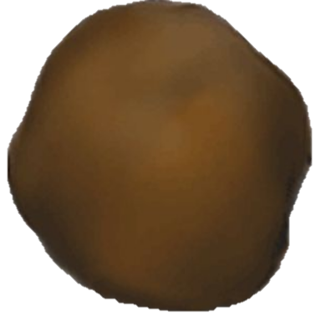

COS fluxes are dependent on several factors !
Notes:
COS fluxes in soils are dependent on many parameters

Slide 10
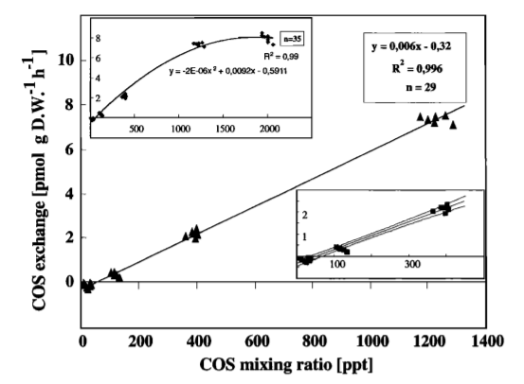


[COS] atm
→ Higher [COS] facilitate COS uptake by organisms
Source : Kesselmeier et.al, 1999
Effect of COS atmospheric concentration on soil COS uptake

Slide 11

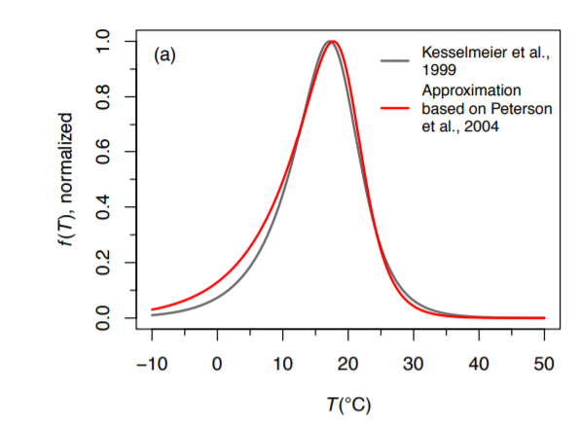
[COS] atm
→ Temperature affects CA efficiency and thus the uptake of COS
Source : Kesselmeier et.al, 1999
Temperature
Source : Kesselmeier et.al, 1999
T°C function of soil COS uptake
Source : Sun et.al, 2015

Slide 12
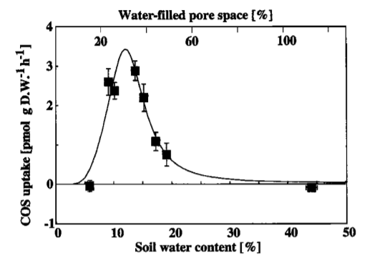

[COS] atm
→ Water is an essential part of the chemical reaction
Source : Kesselmeier et.al, 1999
COS
Temperature
CO₂
H₂S
Source : Kesselmeier et.al, 1999
H₂O
Soil moisture
Source : Kesselmeier et.al, 1999
→ If the soil moisture is too high, then COS diffusion in soil is impaired
Effect of soil moisture on soil COS uptake

Slide 13
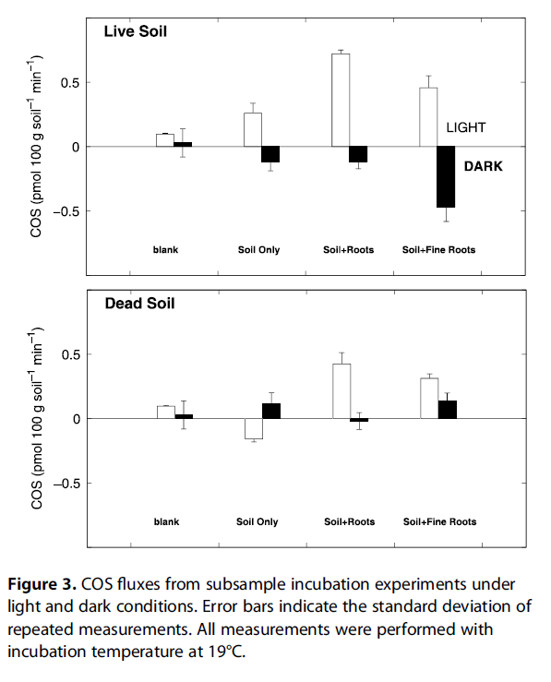

Effect of light on COS fluxes
[COS] atm
Source : Kesselmeier et.al, 1999
Temperature
Source : Kesselmeier et.al, 1999
Soil moisture
Source : Kesselmeier et.al, 1999
Source : Whelan & Rhew, 2014
Light
Source : Sauze et.al, 2017

Slide 14
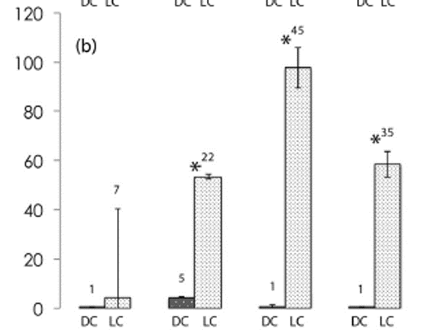
Light conditions
Dark conditions
Phototrophs abundance
In the dark !
pH
Phototrophs gene copies function of pH and light
Source : Sauze et.al, 2017

Slide 15
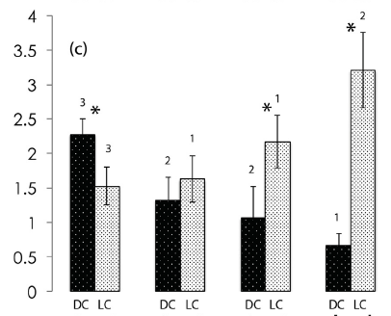
Light conditions
Dark conditions
Phototrophs abundance
pH
Phototrophs gene copies function of pH and light
Source : Sauze et.al, 2017
In the dark !
Fungal abundance
pH
Fungal gene copies function of pH and light
Source : Sauze et.al, 2017

Slide 16
Light conditions
Dark conditions
Phototrophs abundance
pH
Phototrophs gene copies function of pH and light
Source : Sauze et.al, 2017
Fungal abundance
pH
Fungal gene copies function of pH and light
Source : Sauze et.al, 2017

Slide 17
Light conditions
Dark conditions
Phototrophs abundance
pH
Phototrophs gene copies function of pH and light
Source : Sauze et.al, 2017
Fungal abundance increases with pH when associated with phototrophs !
Fungal abundance
pH
Fungal gene copies function of pH and light
Source : Sauze et.al, 2017

Slide 18
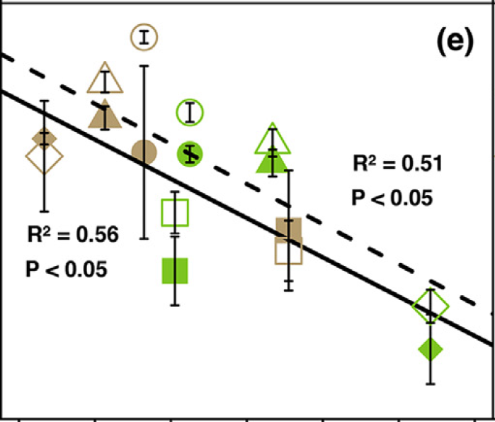

Light conditions
Light conditions
Dark conditions
Dark conditions
Phototrophs abundance
pH
Phototrophs gene copies function of pH and light
Source : Sauze et.al, 2017
COS balance
Fungal gene copies
COS flux function of fungal gene copies
Fungal abundance
Source : Sauze et.al, 2017
Differences in COS fluxes cannot be explained only by microbes' abundances.
→ Understanding community interactions is key
pH
Fungal gene copies function of pH and light
Source : Sauze et.al, 2017

Slide 19
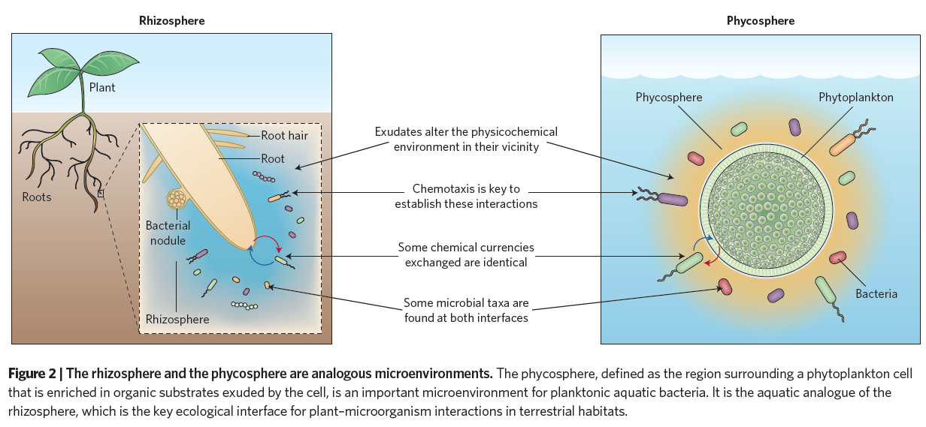
Phycosphere has long been an underestimated source of microbial interactions in marine ecosystems …
Source : Seymour et.al, 2017

Slide 20
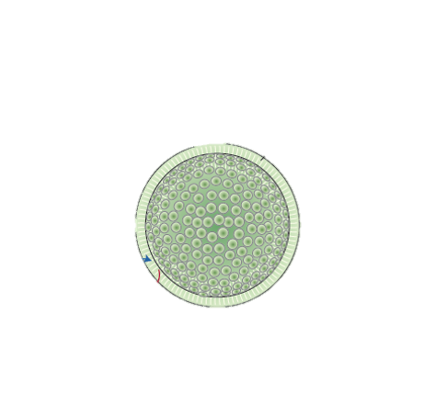

The concept could also apply to free photoautotrophic soil organisms !
Source : Seymour et.al, 2017

Slide 21
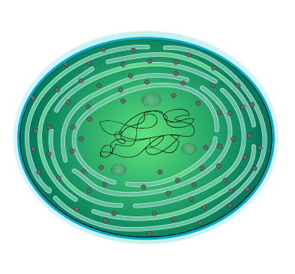
Eukaryotic phototrophs are rarely included in soil studies when it comes to studying microbial communities …
→ scarce tools for taxonomic assignment.
μGREEN-DB
2018 :
from Djemiel et.al, to be published.
reference database for eukaryotic algae and cyanobacteria
aim to provide taxonomic assignment for photoautotrophic organisms

Slide 22



Phototrophic organisms can shape ecosystems on the long term !
→ Cryptogam communities !
Most of them are diazotrophic
→ impact on microbial communities / plants
Depending on pH, moisture, [CO2], they can produce or dissolve limestone.
→ geological shaping.
Source : Budel et.al, 2004
Biocrust in Canyonlands National Park on the Colorado Plateau
Source : Bill Bowman
Notes:
Another aspect to support the importance of phototrophs in soils are cryptogam communities. Gathered and forming biocrusts, they are the stalwart architects of dryland soils, settling in where many plants can’t survive. Biocrusts contributes to soil integrity and helps building its fertility by pulling nitrogen from the air and converting it into a form usable by plants, as well as storing atmospheric carbon. These communities are also capable of producing or dissolving limestone, depending on pH, moisture and atmospheric CO2 concentrations. As such, there are some clues that cryptogams communities could play a role in long term geological shaping.

Slide 23
As part of this study, I will :
→ describe photoautotrophic diversity in soil.

Slide 24
As part of this study, I will :
→ describe photoautotrophic diversity in soil.
determinate whether light affects photoautotrophic, bacterial and fungal community composition.

Slide 25
As part of this study, I will :
→ describe photoautotrophic diversity in soil.
determinate whether light affects photoautotrophic, bacterial and fungal community composition.
evaluate whether changes in microbial community lead to changes in ecosystem function :
soil respiration
photosynthesis rate
COS exchange
CA activity

Slide 26

Thank you

Slide 27
References :
Sandoval-Soto, L, M Stanimirov. « Global Uptake of Carbonyl Sulﬁde (COS) by Terrestrial Vegetation: Estimates Corrected by Deposition Velocities Normalized to the Uptake of Carbon Dioxide (CO2) », 2005, 8.
Whelan, Mary E., Sinikka T. Lennartz, Teresa E. Gimeno, Richard Wehr, Georg Wohlfahrt, Yuting Wang, Linda M. J. Kooijmans, et al. « Reviews and Syntheses: Carbonyl Sulfide as a Multi-Scale Tracer for Carbon and Water Cycles ». Biogeosciences 15, nº 12 (18 juin 2018): 3625‑57.
Büdel, B, B Weber, M Kühl, H Pfanz, D Sültemeyer, D. Wessels. « Cyanobacteria: Bioalkalization Causes Chemical Weathering in Arid Landscapes », 2004, 8.
Smith K.S., Jakubzick C., Whittam T.S., Ferry J.G., « Carbonic anhydrase is an ancient enzyme widespread in prokaryotes », Proceedings of the National Academy of Sciences of the United States of America, 1999 Dec 21.
Kaisermann, Aurore, Jérôme Ogée, Joana Sauze, Steven Wohl, Sam P. Jones, Ana Gutierrez, et Lisa Wingate. « Disentangling the Rates of Carbonyl Sulfide (COS) Production and Consumption and Their Dependency on Soil Properties across Biomes and Land Use Types ». Atmospheric Chemistry and Physics 18, nº 13 (5 juillet 2018): 9425‑40.
Kesselmeier, J., N. Teusch, et U. Kuhn. « Controlling Variables for the Uptake of Atmospheric Carbonyl Sulfide by Soil ». Journal of Geophysical Research: Atmospheres 104, nº D9 (1999): 11577‑84.
Sauze J., Ogée J., Maron P.A., Crouzet O., Nowak V., Wohl S., Kaisermann A., Jones S.P., Wingate L.. « The Interaction of Soil Phototrophs and Fungi with PH and Their Impact on Soil CO2, CO18O and OCS Exchange ». Soil Biology and Biochemistry 115 (1 décembre 2017): 371‑82.
Sun W., Maseyk K., C. Lett, et U. Seibt. « A Soil Diffusion–Reaction Model for Surface COS Flux: COSSM V1 ». Geoscientific Model Development 8, nº 10 (2 octobre 2015): 3055‑70.
Whelan, Mary E., et Robert C. Rhew. « Carbonyl Sulfide Produced by Abiotic Thermal and Photodegradation of Soil Organic Matter from Wheat Field Substrate ». Journal of Geophysical Research: Biogeosciences 120, nº 1 (2015): 54‑62.
J.R. Seymour1 , S.A. Amin, J.B Raina, R. Stocker “Zooming in on the phycosphere: the ecological interface for phytoplankton-bacteria relationships.”, Nature Microbiology, May 2017 - PubMed - NCBI ».

